Slide 1
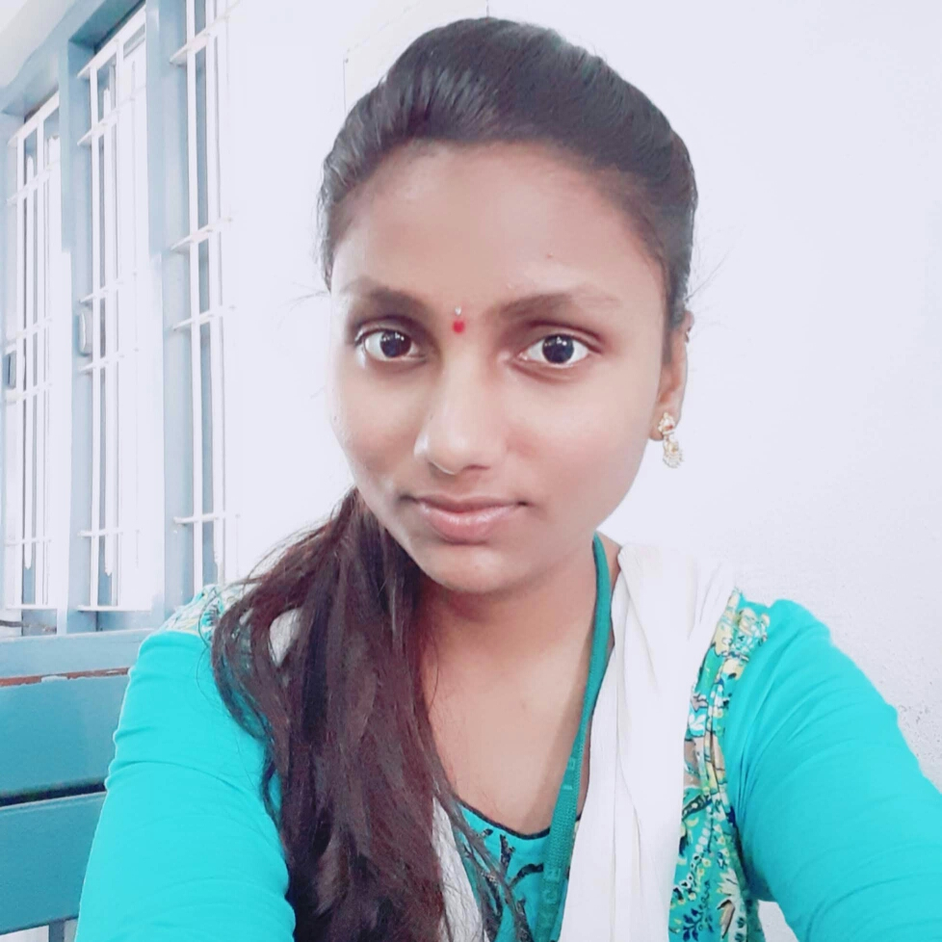

Tejaswi Goda
Analyst/Software Engineer
Bachelor of Technologies
Mechanical Engineering : (2016 – 2020)
Hyderabad
Tejaswi.goda@capgemini.com
Skills
Java Basics
Springboot
Hybernate
+91 6302135423
A4
Web Technologies
HTML5
CSS
JavaScript
React
Full Stack Developer
Proficient in creating Single page Web Application in Angular with Authentication with route guards, Angular reactive forms, angular routing.
I'm prepared to study new technologies and frameworks and use them in order to increase my expertise.
A cooperative individual with strong communication skills who is always willing to contribute to the advancement of knowledge
Has working knowledge of Core Java and Spring Framework.
Expense Tracker:
I have developed an online book store application which contains two main entities, admin and customer and provided different features to both, this project is developed using java, spring, postgresql.
Completed ”Agile Software Development “ course at Coursera
Completed ”AWS CP Certification“ by Amazon
Database
SQl Database
Tools
Git
Postman
Add On Skills
Communications
Team management
Peer learning
Time management

